Slide 1

MEDIVERSE PREDICTIVE HEALTH MONITORING USING
RANDOM FOREST BASED ON USER INPUT
SUBMITTED BY
Under the Esteemed Guidance of
Dr. C.VENKATA SUBBAIAH, _{M.Tech., Ph.D.,}
Associate Professor,
Head of the Department
K. VIJAY KUMAR | 23HM5A0509
G. GAYATHRI PRIYANKA | 22HM1A0534
A. SUMANTH | 22HM1A0503
C. YUGANDHAR | 22HM1A0522
B. HARI KRISHNA | 23HM5A0502

Slide 2
CONTENTS
OBJECTIVE
ABSTRACT
INTRODUCTION
EXISTING SYSTEM
DISADVANTAGES OF EXISTING SYSTEM
PROPOSED SYSTEM
ADVANTAGES OF PROPOSED SYSTEM
SYSTEM REQUIREMENTS
ARCHITECTURE
ALGORITHMS
MODULES
UML DIAGRAMS
TESTING PLAN
SCREENSHOTS
CONCLUSION
FUTURE ENHANCEMENT
REFERENCES

Slide 3
Objective
To develop a predictive health monitoring system using machine learning (Random Forest) that analyzes user health inputs and predicts health status as Good, Medium, or Risk.

Slide 4
abstract
Mediverse Predictive Health Monitoring System is a machine learning based application that predicts a user’s health condition using parameters such as temperature, heart rate, oxygen level, and steps. The system is developed using a Flask web application where users can enter their health data. Machine learning algorithms including SVM, KNN, Linear Model, and Random Forest are used and evaluated using Accuracy, Recall, and F1-score. Random Forest is selected as the best model for prediction. The system classifies health status as Good, Medium, or Risk and also provides basic health recommendations.

Slide 5
INTRODUCTION
Mediverse Predictive Health Monitoring System is a machine learning based web application that helps predict a user’s health condition using basic health parameters such as temperature, heart rate, oxygen level, and steps. The system is developed using a Flask application where users can enter their health data. Machine learning algorithms like SVM, KNN, Linear Model, and Random Forest are used to analyze the data and predict the health status. The system classifies the result as Good, Medium, or Risk and also provides simple health recommendations. This helps users monitor their health and take preventive actions.

Slide 6
EXISTING SYSTEM
Existing systems such as JARVIS, Blackbox, and Athos are primarily designed for fitness and wellness monitoring rather than clinical healthcare. They track parameters like heart rate, muscle activity, and physical performance using threshold-based, basic signal processing, and statistical analysis algorithms. While suitable for fitness tracking, these methods are not adequate for accurate medical health risk prediction.
These systems rely on cloud-based data processing, which may introduce latency in time-sensitive healthcare situations. Their visualization is limited to 2D dashboards, and they lack medical interoperability, making them unsuitable for hospital-level health monitoring and clinical integration.

Slide 7
Disadvantages
Existing systems mainly focus on fitness tracking and do not provide accurate real-time health monitoring for medical purposes.
Health information is shown using basic dashboards, and these systems do not connect with hospital or healthcare systems.
They have limited security, scalability, and medical compatibility, making them not suitable for advanced healthcare applications.

Slide 8
PROPOSED SYSTEM
The proposed system is a machine learning-based health risk prediction web application developed using Python and Flask. The system collects user health inputs such as temperature, daily steps, health index, flu information, heart rate, and oxygen level through a web interface. The system trains and compares multiple machine learning models including SVM, KNN, Linear model, and Random Forest using accuracy, recall, and F1-score. Based on performance evaluation, Random Forest is selected as the final model for prediction. The system then classifies the user's health condition into categories such as Risk, Good, Medium and provides health recommendations.

Slide 9
Advantages
The system compares multiple machine learning models (SVM, KNN, Linear, Random Forest) using accuracy, recall, and F1-score, and selects the best-performing model for prediction.
Random Forest is used as the final model to predict the user's health condition (Risk,Medium,Good) based on multiple health parameters.
The system analyses several health inputs such as temperature, daily steps, health index, flu status, heart rate, and oxygen level to improve prediction reliability.

Slide 10
SYSTEM REQUIREMENTS
SOFTWARE REQUIREMENTS
Operating system -Windows 7 or higher
Editor - Sublime editor or Visual studio code.
Coding Language - Python
Front-End - HTML, CSS, JAVASCRIPT
Back-End - Python, Flask
Deployment - Localhost / Web server
Database - Excel

Slide 11
HARDWARE REQUIREMENTS
Processor - Pentium - IV
RAM - 4 GB (min)
Hard Disk - 20 GB
Monitor - SVGA
Key Board - Standard Windows Keyboard
Mouse - Two or Three Button Mouse

Slide 12
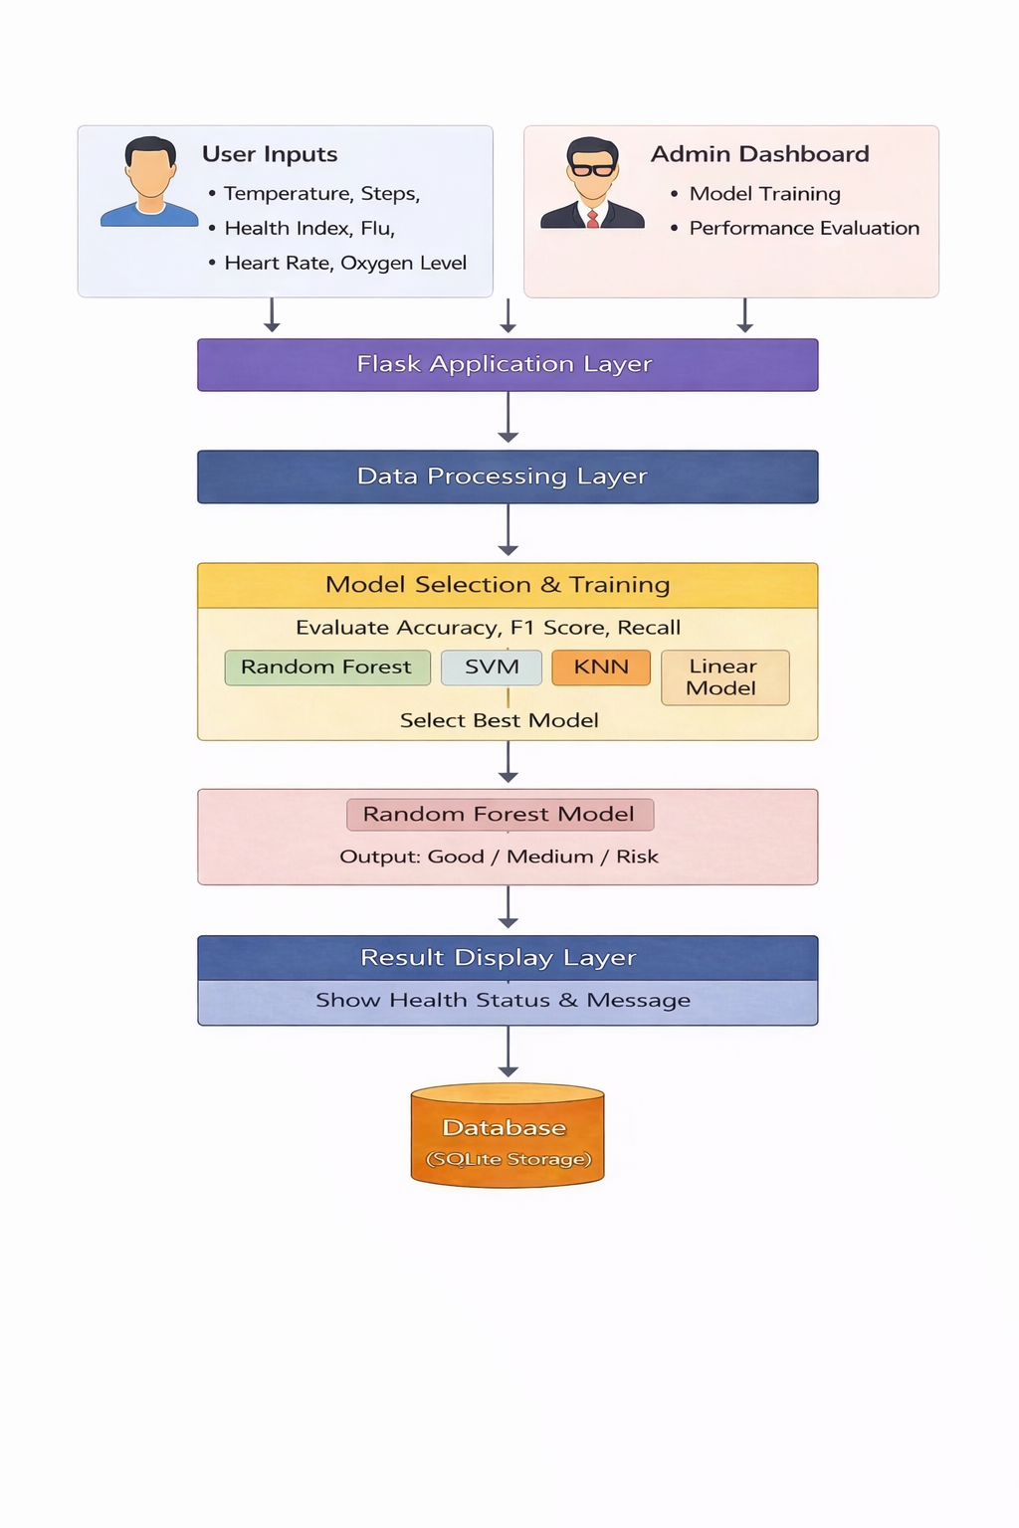
ARCHITECTURE

Slide 13
ALGORITHMS
Input Data Acquisition Algorithm
Data Preprocessing Algorithm
Model Training & Evaluation Algorithm
Health Risk Prediction Algorithm (Random Forest-ML)
Result Display & Recommendation Algorithm

Slide 14
Input Data Acquisition Algorithm
Purpose: Collect health data from system input.
The system loads the health dataset (Excel/CSV) for model training in the admin module.
The system collects user health inputs (temperature, steps, health index, flu, heart rate, oxygen level) through the web form.
Data Preprocessing Algorithm
Purpose: Prepare raw health data for ML model.
The dataset is validated and checked for structure and correctness before training.
The data is split into training and testing sets for model evaluation.

Slide 15
Model Training & Evaluation Algorithm
Purpose: Core machine learning prediction.
The system trains SVM, KNN, Linear, and Random Forest models using the dataset.
Their performance is compared using accuracy, recall, and F1-score, and the best model is selected.
Health Risk Prediction Algorithm (Random Forest-ML)
Purpose: Predict the health risk.
The selected Random Forest model receives user health inputs.
It predicts the health status as Good, Medium, or Risk.
Result Display & Recommendation Algorithm
Purpose: Provide actionable system output.
The predicted health category is returned from the model to the Flask application.
The result (Good / Medium / Risk) along with a corresponding message is displayed on the user interface.

Slide 16
MODULES
Data Collection Module
Data Preparation Module
Model Selection Module
Model Training Module
Prediction and Recommendation Module

Slide 17
Data Collection Module
Loads the health dataset from a CSV file for model training.
Receives user health inputs through the web form.
Uses parameters: Temperature, Daily Steps, Health Index, Flu, Heart Rate, and Oxygen Level.
Data Preparation Module
Validates the dataset structure and checks for missing values.
Selects required health features for training.
Splits the dataset into training and testing sets.

Slide 18
Model Selection Module
Trains multiple models: SVM, KNN, Linear, and Random Forest.
Evaluates models using accuracy, recall, and F1-score.
Selects Random Forest as the best-performing model.
Model Training Module
Trains the Random Forest model using the prepared dataset.
Learns the relationship between health parameters and risk level.
Saves the trained model for prediction use.
Prediction and Recommendation Module
Accepts user health input for prediction.
Uses the trained Random Forest model to predict Good, Medium, or Risk.
Displays the predicted health status and message on the user interface.

Slide 19
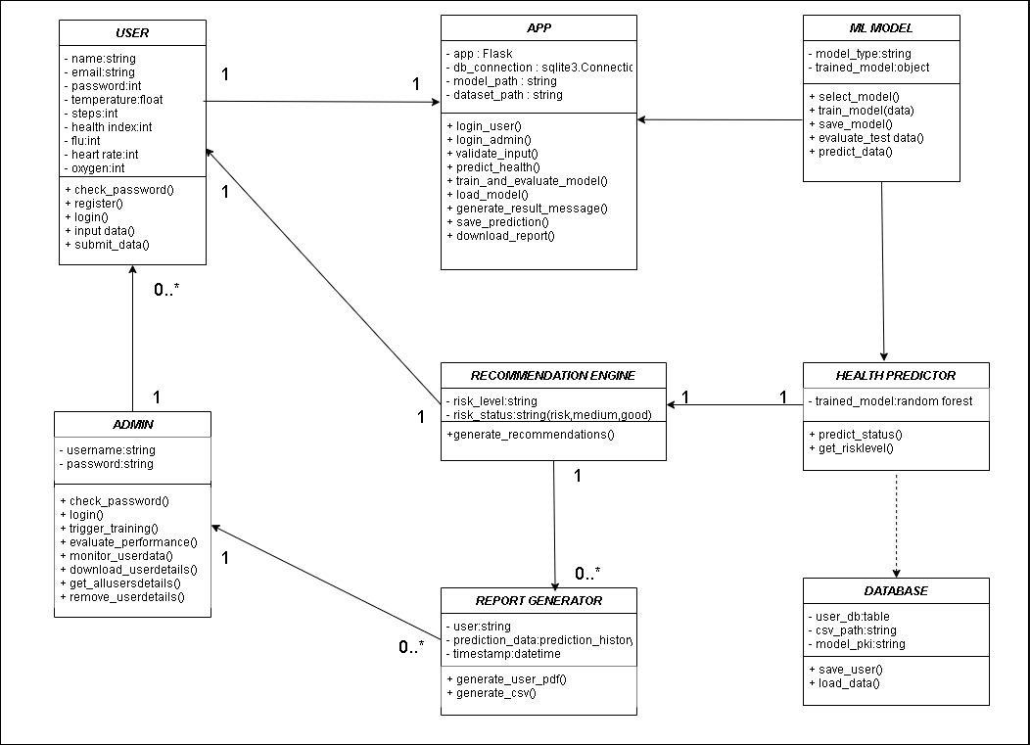
UML DIAGRAMS
Class Diagram

Slide 20
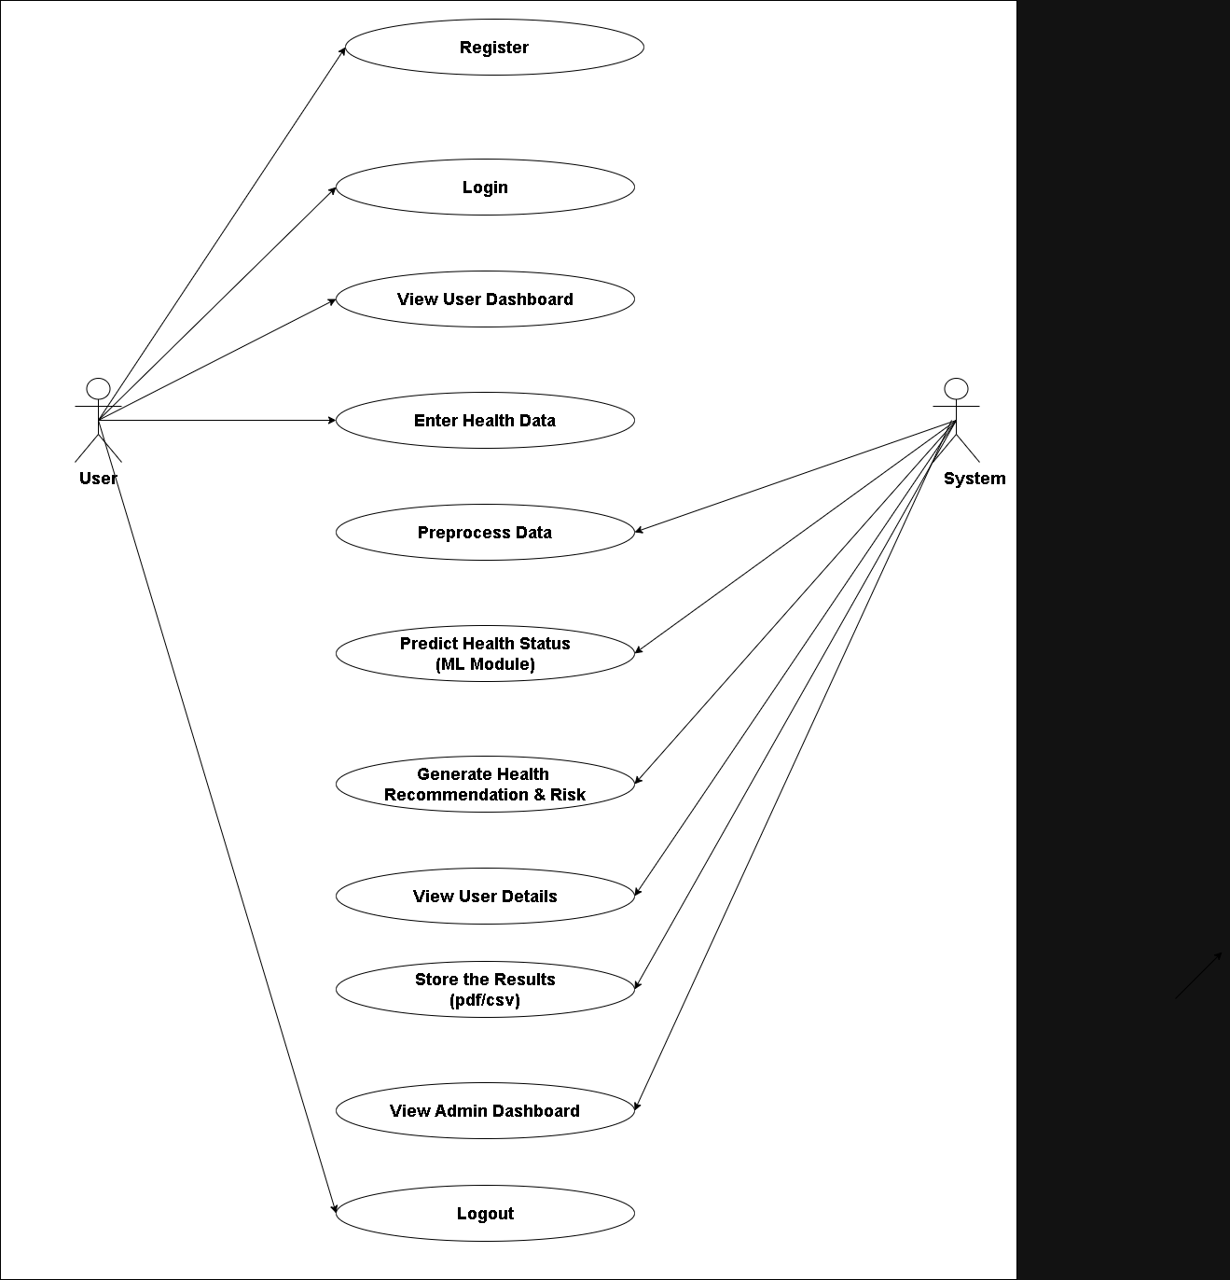
Use Case Diagram

Slide 21
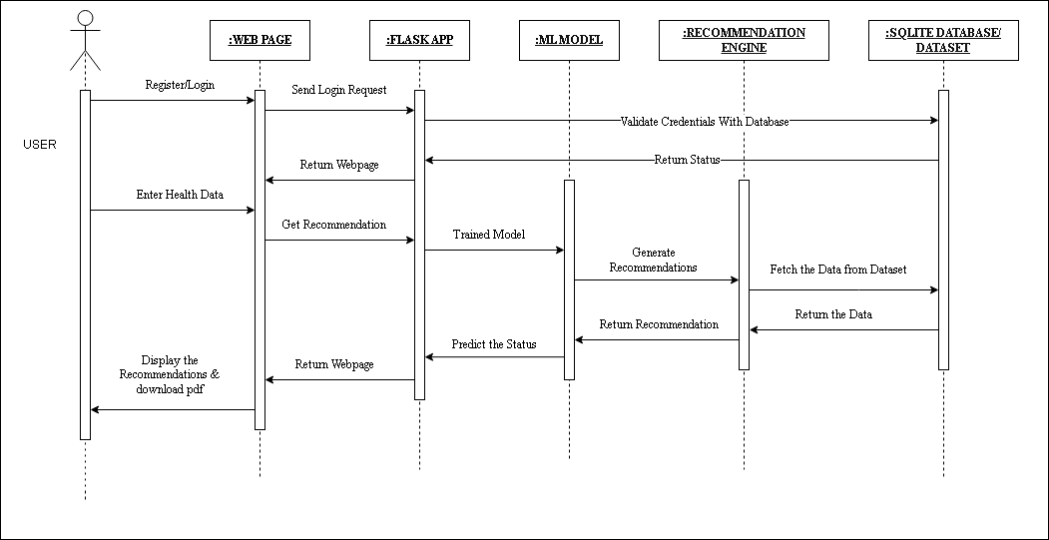
Sequence Diagram

Slide 22
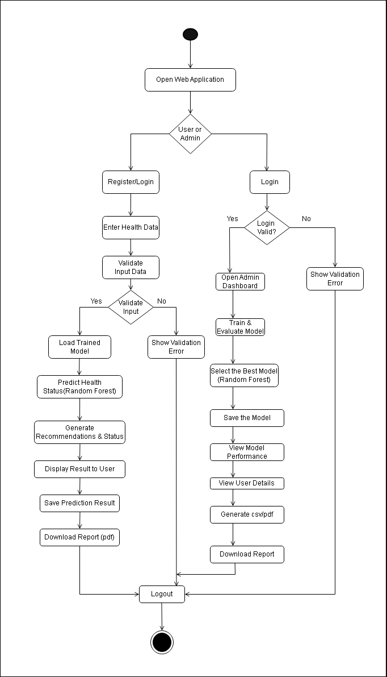
Activity Diagram

Slide 23
TESTING
Testing Plan
The testing plan for the Health Risk Prediction System defines the process used to verify that all components of the application function correctly and meet project requirements. It ensures that user authentication, health data processing, machine learning prediction, database storage, and report generation operate accurately and reliably.
Unit Testing
Tested user registration and login functions to ensure correct storage and authentication in SQLite database.
Verified health input validation to check numeric conversion and error handling.
Tested Random Forest prediction function to confirm correct output (Good / Medium / Risk).
Integration Testing
Tested Admin workflow for dataset upload, model training, and model saving.
Confirmed prediction results are properly stored and retrieved from the database.

Slide 24
System Plan
Tested full user process: Register → Login → Enter Data → Predict → View Result → Download Report.
Tested full admin process: Login → Train Model → View Performance → Manage User Records.
Ensured the system runs smoothly without errors during complete execution.
Functional Testing
Verified login authentication for both User and Admin with valid and invalid credentials.
Confirmed correct classification output (Good / Medium / Risk) based on user health data.
Ensured user details and prediction history are correctly stored in SQLite.
Performance & Model Evaluation Testing
Compared SVM, KNN, Linear, and Random Forest algorithms.
Evaluated model performance using Accuracy, Precision, Recall, and F1-Score.
Confirmed Random Forest was selected as the best-performing model and saved for prediction.

Slide 25
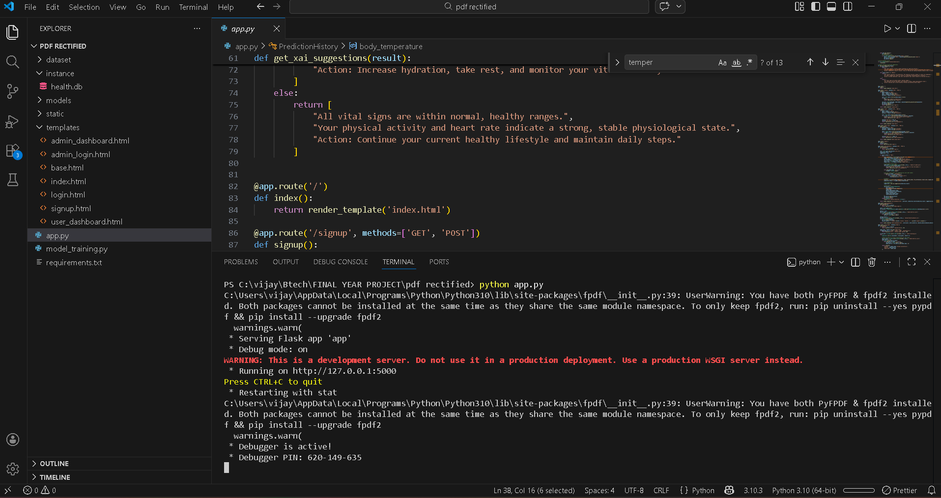
SCREENSHOTS
Open URL in any browser to access the webpage

Slide 26
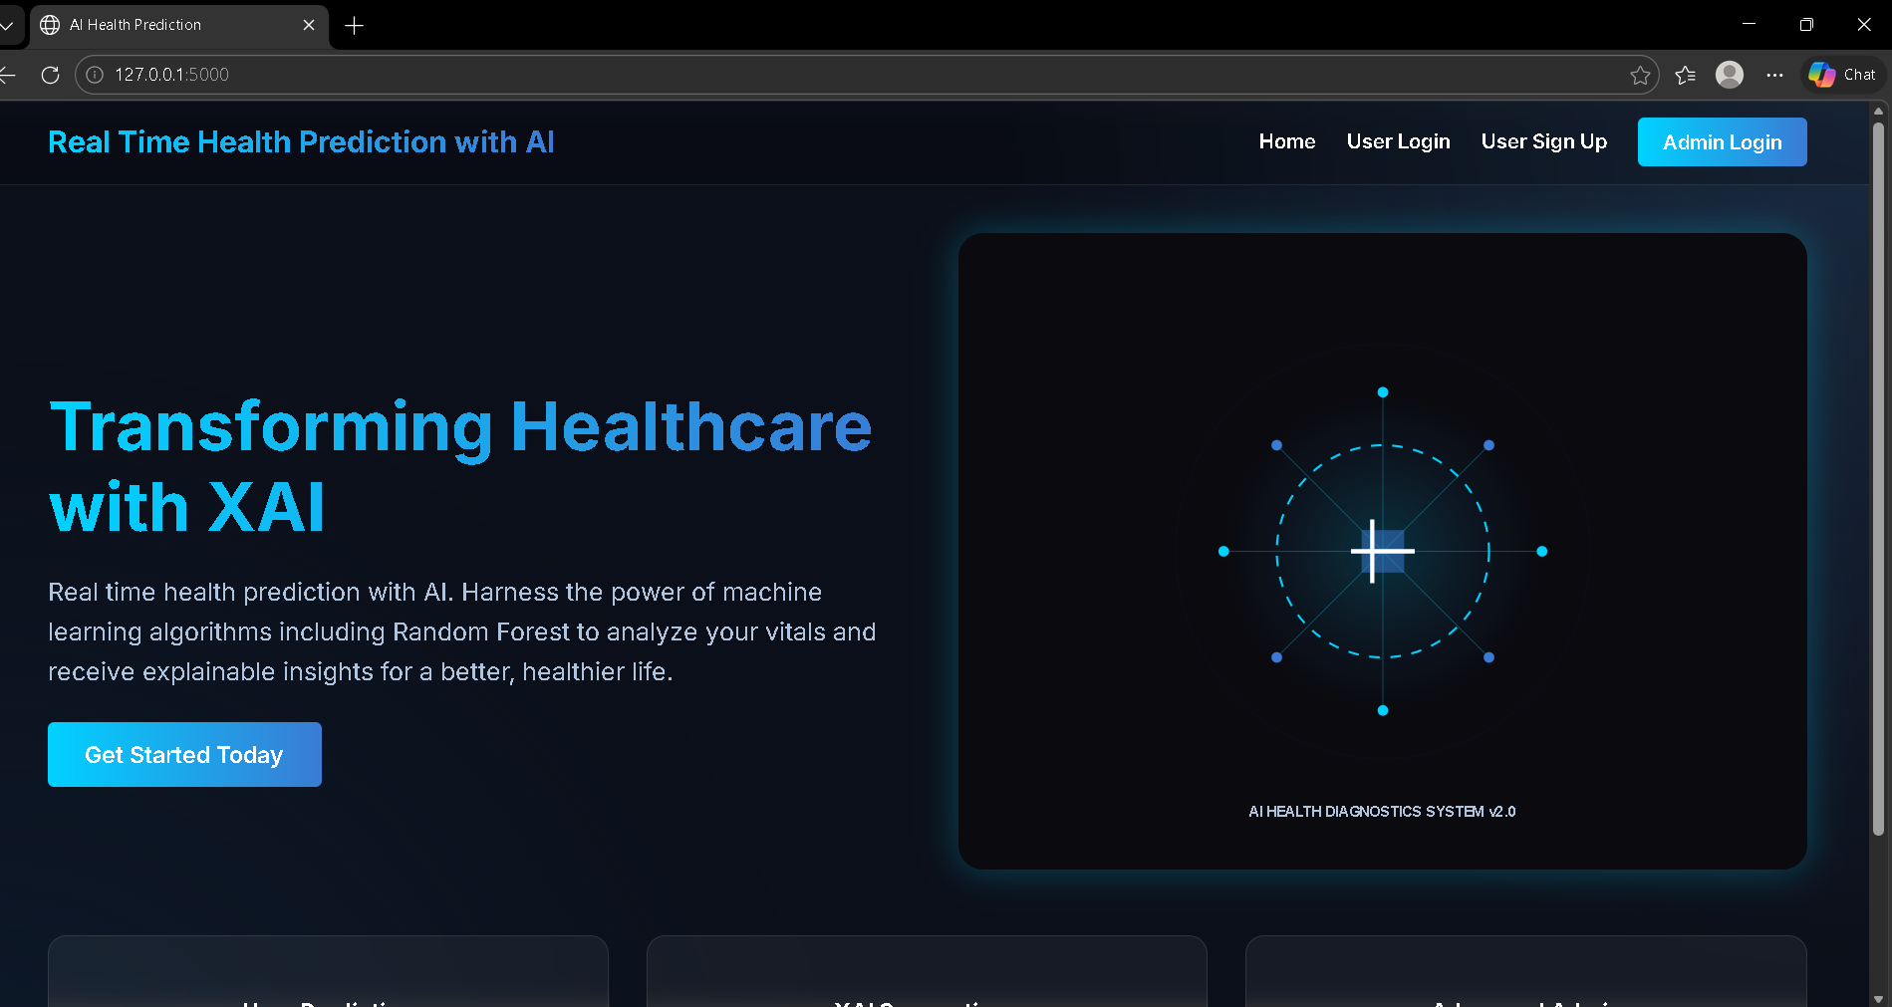
Choose Login Type

Slide 27
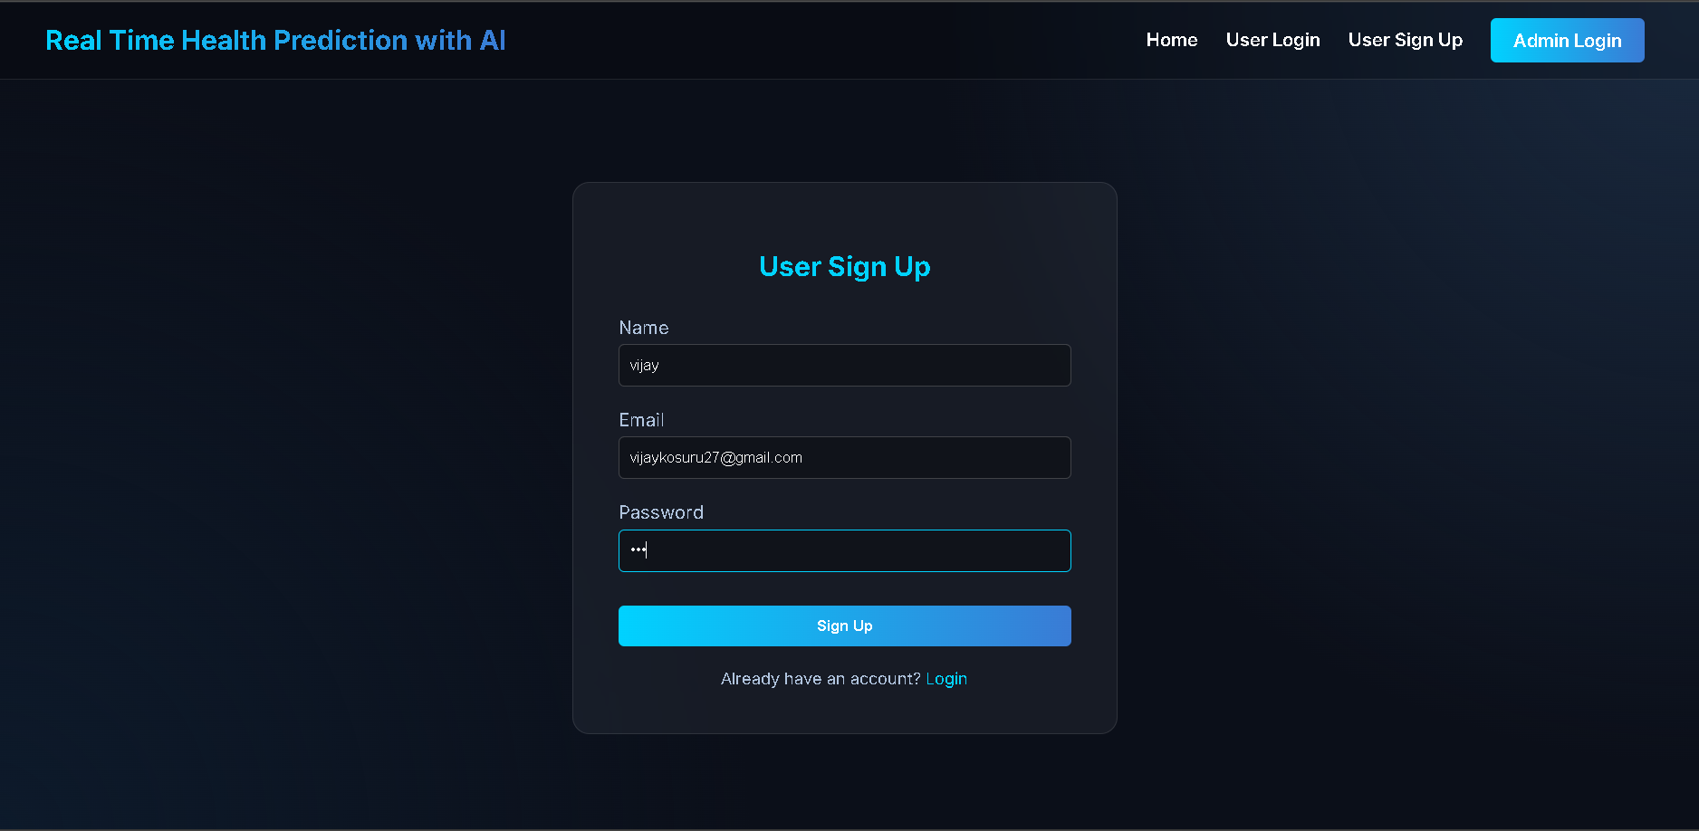
For User Sign Up Process

Slide 28
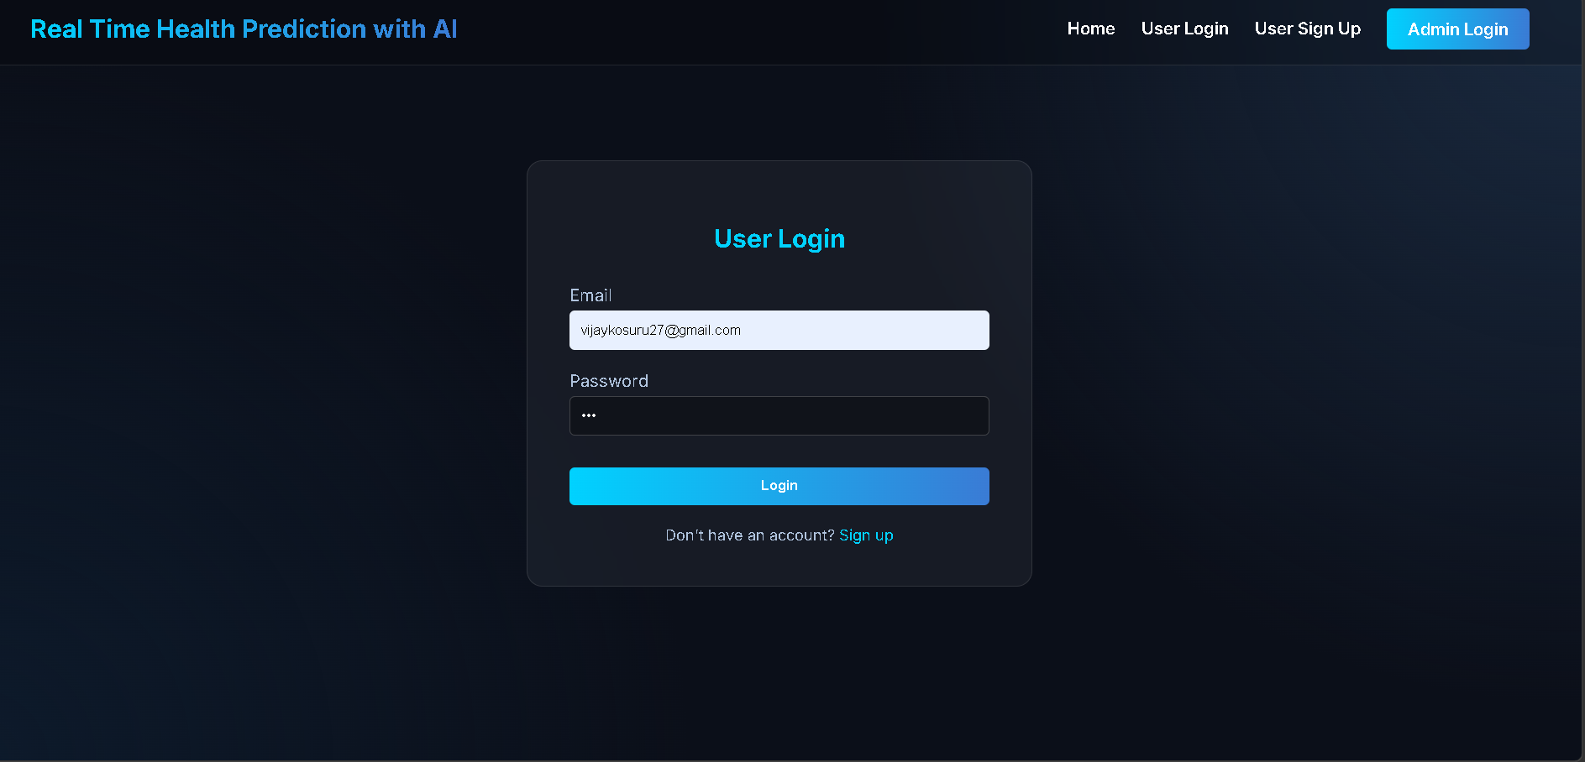
After Sign Up Login the user Credentials

Slide 29
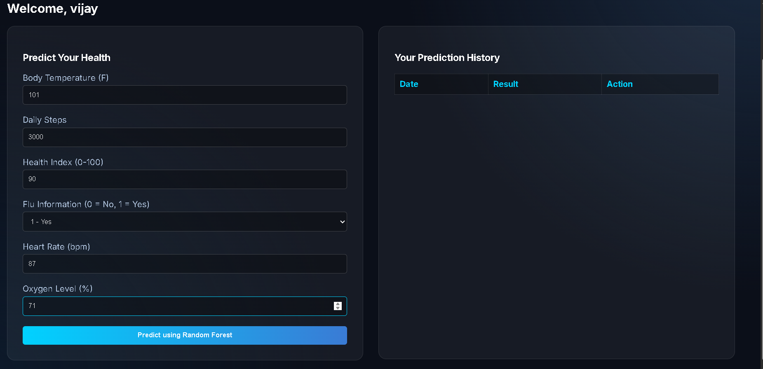
Fill the Health Details

Slide 30
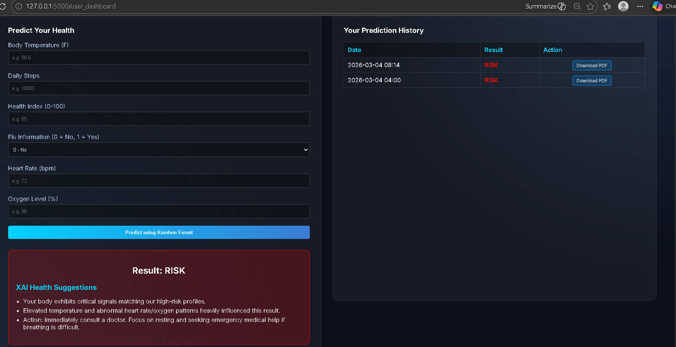
XAI Health Suggestions for Health & Result Status

Slide 31
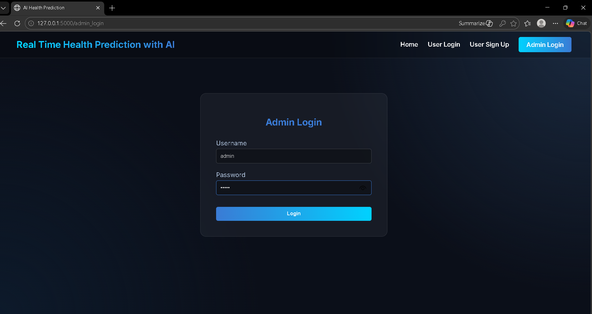
Login Admin Credentials

Slide 32
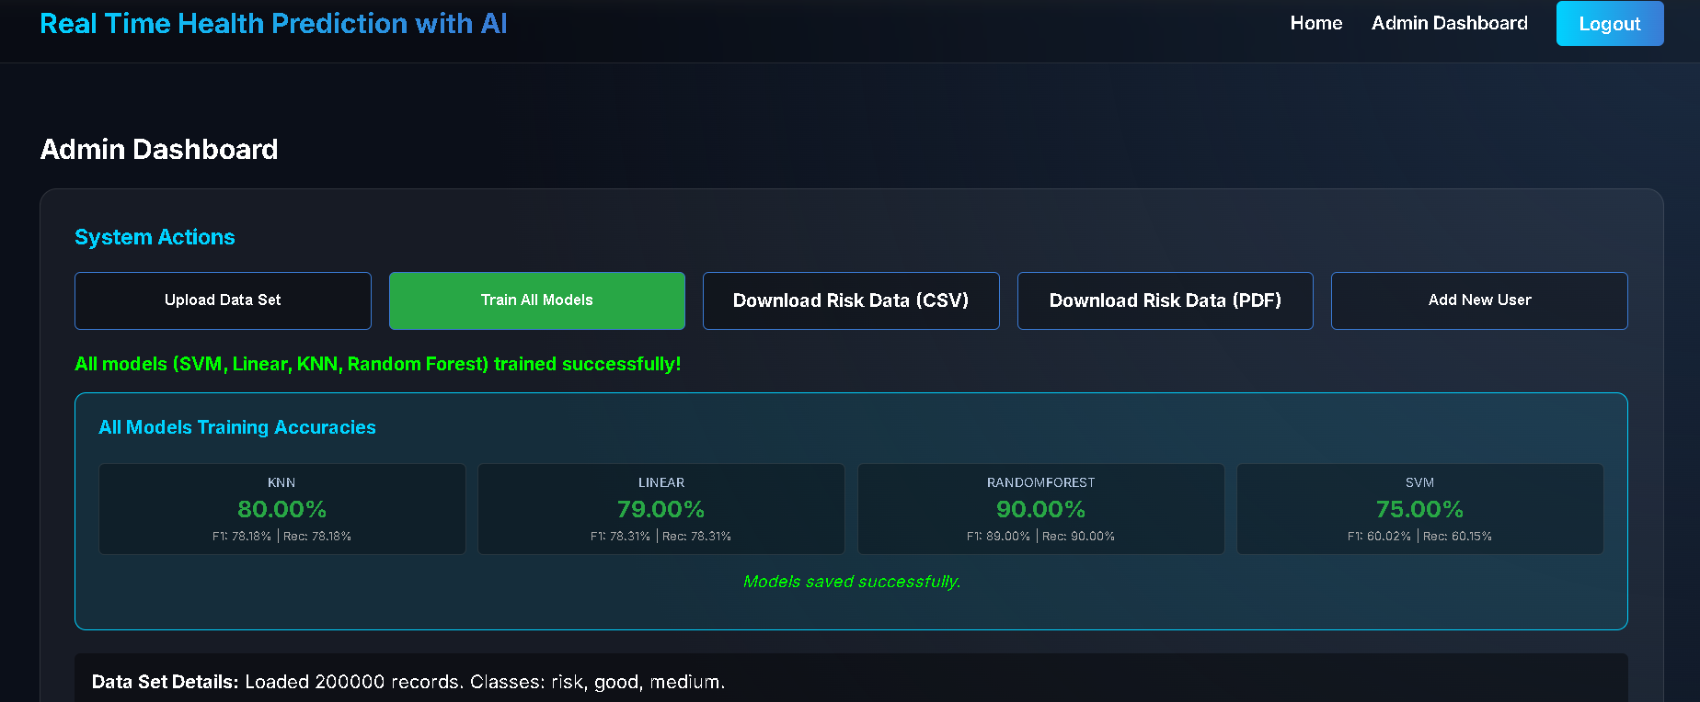
For Admin Dashboard

Slide 33
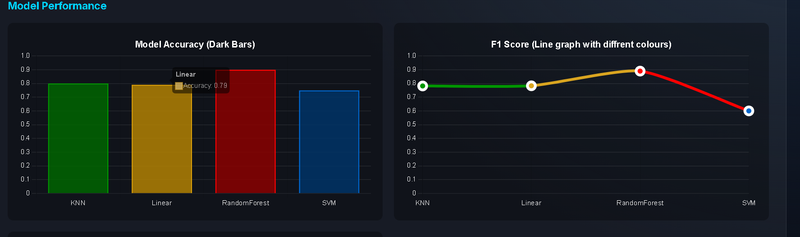
Model Performance for Trained Model

Slide 34
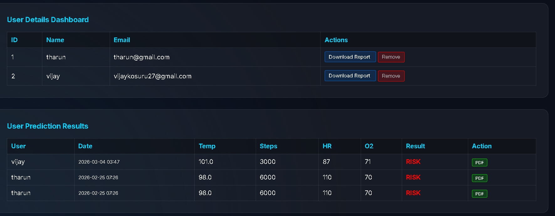
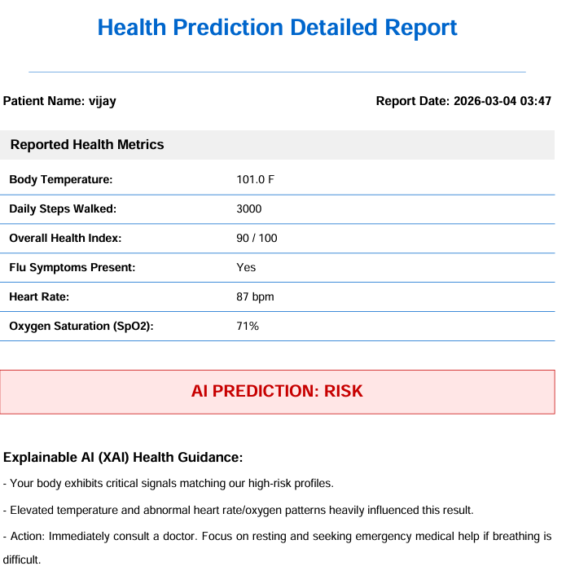
Download Report for User Details

Slide 35
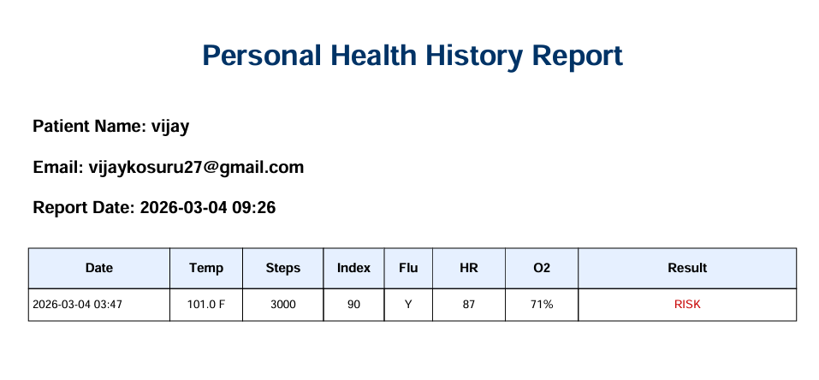
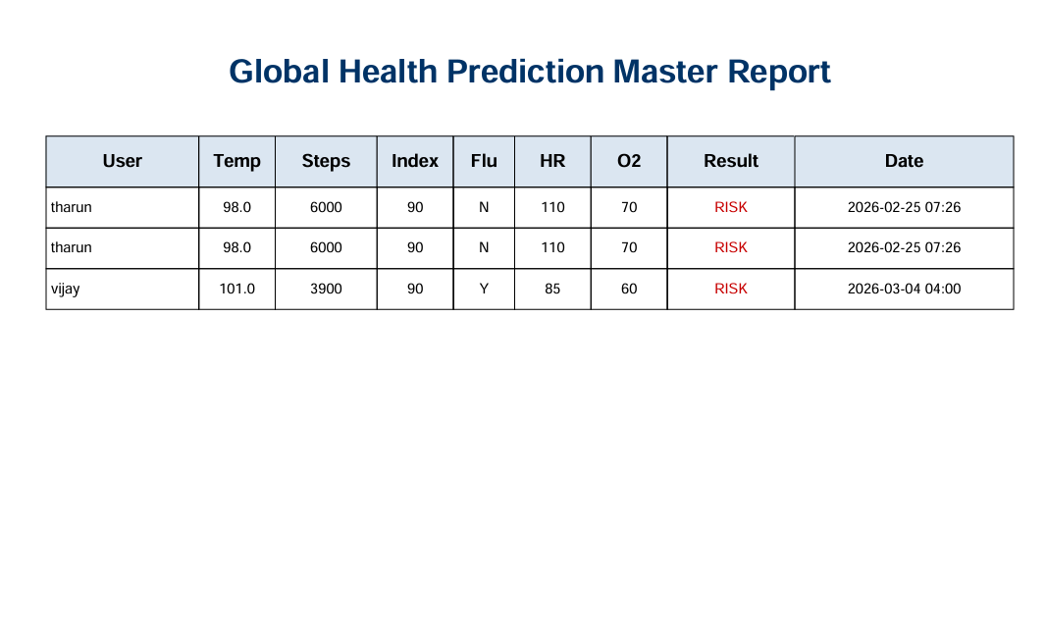
Download the Health Report Individual (pdf)
Download All Users Details

Slide 36
Conclusion
The Health Risk Prediction System was successfully developed using Flask, Machine Learning, and an SQLite database. The system allows users to enter health details and receive a prediction result classified as Good, Medium, or Risk. Different machine learning models were evaluated, and Random Forest was selected based on its superior performance. The Admin module supports model training, dataset management, and monitoring of user records. Overall, the system provides a reliable, accurate, and user-friendly solution for health risk.

Slide 37
Future Enhancement
Real-Time Sensor Integration
Currently, users manually enter health data. In the future, the system can be connected to wearable devices (like smartwatches or IoT sensors) to automatically collect heart rate, oxygen level, and other health parameters.
Enhanced Security Features
Future versions can include password encryption, role-based access control, and secure authentication mechanisms for better data protection.
Mobile Application Development
A mobile app version can be developed to make the system more accessible and user-friendly for daily health monitoring.

Slide 38
References
1] A. Bose et al., “Machine learning-based predictive model for health status classification,” Computers in Biology and Medicine, vol. 175, 108765, 2025. This paper proposes a machine learning model for classifying patient health status using clinical data.
[2] R. Jain et al., “Data-driven healthcare prediction using Random Forest algorithm,” Expert Systems with Applications, vol. 240, 121234, 2025. The authors developed a healthcare prediction system using the Random Forest algorithm.
[3] N. Das et al., “Health monitoring system using machine learning and web technologies,” International Journal of Advanced Computer Science and Applications, vol. 16, no. 2, 2024. This paper presents a web-based health monitoring system integrating machine learning techniques.
[4] D. Mehta et al., “Early disease prediction using machine learning algorithms,” Applied Intelligence, vol. 53, pp. 1123–1135, 2024. The study focuses on early disease detection using algorithms such as SVM, Decision Tree, and Logistic Regression.
[5] V. Rao et al., “Performance evaluation of classification algorithms for health prediction,” Procedia Computer Science, vol. 225, pp. 1456–1465, 2023. This paper compares various classification algorithms based on performance metrics like accuracy and recall.

Slide 39
[5] V. Rao et al., “Performance evaluation of classification algorithms for health prediction,” Procedia Computer Science, vol. 225, pp. 1456–1465, 2023. This paper compares various classification algorithms based on performance metrics like accuracy and recall.
[6] H. Khan et al., “Predictive analytics in healthcare using supervised learning models,” Journal of Healthcare Engineering, vol. 2023, Article ID 556789, 2023. The authors explore supervised learning techniques for healthcare prediction.
[7] T. Singh et al., “Machine learning-based health monitoring system using IoT and data analytics,” Sensors, vol. 23, no. 4, 2023. This work presents an IoT-based system that collects real-time health data and uses machine learning for analysis.
[8] S. Verma et al., “Random Forest-based health prediction system using clinical data,” Expert Systems with Applications, vol. 198, 116789, 2022. The study uses the Random Forest algorithm to predict diseases based on clinical datasets.

Slide 40
Thank You
Notes:
Are there any questions, comments or concerns?
All data was provided by the Google Analytics Professional Certification, and I’m using the most recent 12 months of data that was provided.
I used Excel to clean, organize and sort all the data that was available
I also used Excel to create the visual.

